Slide 1
The increasing role of data science in undergraduate statistics programs: new guidelines, new opportunities, and new challenges
Nicholas Horton, nhorton@amherst.edu
American Statistical Association Education Program Webinar
February 3, 2015

Slide 2
Guidelines for undergraduate statistics programs
While we wait, please download the report:http://www.amstat.org/education/curriculumguidelines.cfm
You are encouraged to submit questions for the discussion to follow the presentation

Slide 3
Thanks to workgroup members
Beth Chance (Cal Poly San Luis Obispo)
Stephen H. Cohen (National Science Foundation)
Scott Grimshaw (Brigham Young University)
Johanna Hardin (Pomona College)
Tim Hesterberg (Google)
Roger Hoerl (Union College)
Nicholas Horton (Amherst College, chair)
Chris Malone (Winona State University)
Rebecca Nichols (American Statistical Association)
Deborah Nolan (University of California, Berkeley)

Slide 4
Additional thanks
ASA President Nat Schenker
Megan Murphy, Val Nirala, and Sara Davidson for their graphic design work
Steve Pierson and Jeff Myers for their valuable contributions
Many others who provided critically important feedback and suggestions

Slide 5
Source: NSF IPEDS

Slide 6
Growth and demand
McKinsey & Company report stated that “by 2018, the United States alone could face a shortage of 140,000 to 190,000 people with deep analytical skills as well as 1.5 million managers and analysts with the know-how to use the analysis of big data to make effective decisions”
A large number of those workers will be at the bachelors level
How do we ensure that they have appropriate training to be successful?

Slide 7
Math Sciences in 2025 report
“Two major drivers of increased reach: ubiquity of computational simulations … and exponential increases in the amount of data available” (p. 6)
“Scientific computing pursued in non-unified way” (p. 9)

Slide 8
Committee on the Undergraduate Program in Mathematics (CUPM) 2015
Cognitive Recommendation 3:
Students should learn to use technological tools. Mathematical sciences major programs should teach students to use technology effectively, both as a tool for solving problems and as an aid to exploring mathematical ideas.
Use of technology should occur with increasing sophistication throughout a major curriculum.

Slide 9
CUPM 2015
Content Recommendation 3: Mathematical sciences major programs should include concepts and methods from data
analysis, computing, and mathematical modeling.
Students often face quantitative problems to which analytic methods do not apply.
Solutions often require data analysis, complex mathematical models, simulation, and tools from computational science.

Slide 10
Why is computing so important? Motivating example
Setting: Let A, B, and C be independent random variables each distributed uniform in the interval [0,1].
Question: What is the probability that the roots of the quadratic equation given by Ax^2 + Bx + C = 0 are real?
Source, Rice Mathematical Statistics and Data Analysis third edition exercise 3.11 [also in first and second editions]

Slide 11
The analytic solution

Slide 12
The analytic solution

Slide 13
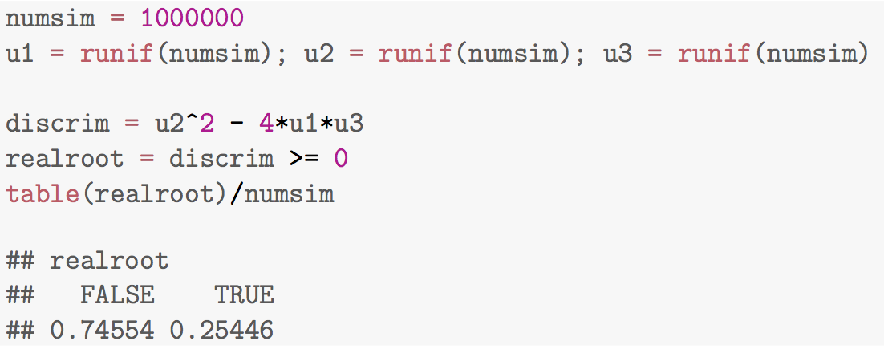
Rice example: empirical problem solving
Straightforward to simulate in R (noting that roots will be real only if the discriminant is non-negative):

Slide 14
Rice example: empirical problem solving
Straightforward to simulate in R (noting that roots will be real only if the discriminant is non-negative):
Rice reports the correct answer
as 1/9 (in all three editions!)

Slide 15
Why is computing so important?
Math Sciences 2025: “The ability to simulate a phenomenon is often regarded as a test of our ability to understand it” (p. 74)
Implication: it’s hard to get probability problems wrong if you can check them in this manner
Still useful to be able to get the correct answer (and not just an approximation)
Goal: develop parallel empirical and analytical problem-solving skills

Slide 16
Undergraduate guidelines (endorsed 2014)

Slide 17
Executive summary: solve real-world problems
Increased importance of data-related skills in modern practice
More emphasis on teamwork, communications, and related experiences (e.g., internships, REUs, and capstones)
Motivation: other disciplines have staked their claim
As statisticians, we run the risk of becoming irrelevant if we don’t aggressively engage

Slide 19
Key skills
Effective statisticians at any level display an integrated combination of skills (statistical theory, application, data and computation, mathematics, and communication)
Students need scaffolded exposure to develop connections between statistical concepts/theory and their application to statistical practice
Programs should provide their students with sufficient background in each of these areas

Slide 21
Curriculum for statistics majors
Statistical method and theory
Data-related topics and computation
Mathematical foundation
Statistical practice

Slide 22
Statistical method and theory
Statistical theory (e.g., distributions of random variables, likelihood theory, point/interval estimation, hypothesis tests, decision theory, Bayesian methods, and resampling)
Exploratory and graphical data analysis
Design of studies (e.g., random assignment, random selection, data collection, and efficiency) and issues of bias, causality, confounding
Statistical models (e.g., variety of linear and non-linear parametric, semi-parametric, and non-parametric regression models)

Slide 23
Key changes: more diverse models/approaches
The expectations for statistical modeling go far beyond a second course in statistics
Students need exposure and practice with a variety of predictive and explanatory models
Need to refine methods for model building and assessment
Need to understand design, confounding, and bias
Need to be able to apply their knowledge of theoretical foundations to the sound analysis of data

Slide 25
Mathematical foundation
The study of mathematics lays the foundation for statistical theory
Undergraduate statistics majors should have a firm understanding of why and when statistical methods work
They should be able to communicate in the language of mathematics and explain the interplay between mathematical derivations and statistical applications

Slide 26
Mathematical foundation (cont.)
Calculus (e.g., integration and differentiation)
Linear algebra (e.g., matrix manipulations, linear transformations, projections in Euclidean space, eigenvalues/eigenvectors, and matrix decompositions)
Probability (e.g., properties of univariate and multivariate random variables, discrete and continuous distributions)
Emphasis on connections between concepts in these mathematical foundation courses and their applications in statistics (e.g. Markov chains)

Slide 28
Key changes: importance of data science
Working with data requires extensive computing skills far beyond those described in the previous guidelines
Students need facility with professional statistical analysis software, the ability to access and “wrangle” data in various ways, and the ability to utilize algorithmic problem-solving
Students need to be able to be fluent in higher-level languages and be facile with database systems

Slide 30
Data-related topics
Use of one or more professional statistical software environments
Data analysis skills undertaken in a well-documented and reproducible manner
Basic programming concepts (e.g., breaking a problem down into modular pieces, algorithmic thinking, structured programming, debugging, and efficiency)
Computationally intensive statistical methods (e.g., iterative methods, optimization, resampling, and simulation/Monte Carlo methods)

Slide 31
Key changes: ability to communicate
Students need to be able to communicate complex statistical methods in basic terms to managers and other audiences and visualize results in an accessible manner
They need a clear understanding of ethical standards
Programs need to provide multiple opportunities to refine these statistical practice skills

Slide 32
Statistical practice
Effective technical writing, presentation skills, and visualizations
Practice with teamwork and collaboration
Ability to interact with and communicate with a variety of clients and collaborators

Slide 34
Recommendations for minors
Hard to meet all of these guidelines for a major program!
Key focus for minor programs:
General statistical methodology
Statistical modeling (e.g., simple and multiple regression, confounding, diagnostics)
Facility with professional statistical software, along with data management skills
Multiple experiences analyzing data and communicating results

Slide 35
Recommendations at the core of the guidelines
Students need to be able to “think with data” (Lambert)
Need multiple opportunities to analyze messy data using modern statistical practices
Key theoretical concepts (design and confounding!) need to be integrated with data preparation, analysis, and interpretation
Mathematical techniques play a lesser role (still important for people planning doctoral work in theoretical statistics)

Slide 36
Next steps
Faculty development
Engagement with two year colleges
Surveys of graduates and employers
Certification/accreditation pathway
Multiple pathways for introduction to statistics
Periodic review

Slide 37
The increasing role of data science in undergraduate statistics programs: new guidelines, new opportunities, and new challenges
Nicholas Horton, nhorton@amherst.edu
American Statistical Association Education Program Webinar
February 3, 2015

Slide 38
Guidelines for undergraduate statistics programs
Download the report:http://www.amstat.org/education/curriculumguidelines.cfm
Please submit questions for the discussion

