Slide 1
Big Data in the Undergraduate Curriculum
ASA Working Group to Revise the Undergraduate Statistics Curriculum
Fall 2013

Slide 2
Plan
Introduction
Brief descriptions of Big Data in various contexts
Questions for panel
Open discussion

Slide 3
What is Big Data?

Slide 4
What is Big Data?
I don’t know

Slide 5
What is Big Data?
I don’t know
Massive amounts of rectangular data
Non-rectangular data (e.g., medical records)
Text files
Any dataset we don’t know how to analyze

Slide 6
Big Data for Undergrads (?)
Big data is everywhere
Despite the “data” connection, words like “statistics” are rarely used in discussion of Big Data
Many undergrads are drawn to statistics because of the sexy nature of Big Data
Undergraduate programs should be producing people who can work effectively on Big Data problems

Slide 7
To think about…
What does statistics have to offer?
What does statistics lack?
How can we differentiating computational issues and statistical thinking issues?

Slide 8
Panelists
Bonnie Ray, Director, Optimization Research, Business Analytics and Math Sciences, IMB
Michael Rappa, Executive Director of the Institute for Advanced Analytics and Distinguished University Professor, NC State
Chris Volinsky, Director, Statistics Research Department, AT&T Labs-Research
Hilary Parker, Data Analyst, Etsy

Slide 9
Bonnie Ray
Director, Optimization Research Business Analytics and Math Sciences IBM T.J. Watson Research Center

Slide 10
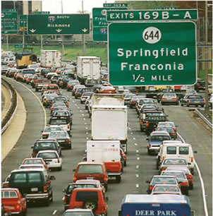
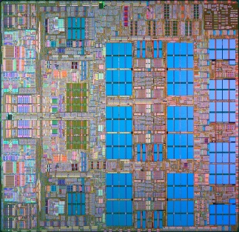
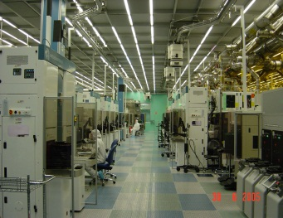
IBM Research Business Analytics and Math Sciences
Improved profitability through analysis of customer networks for a major telecom customer by providing better customer targeting
Deployed operational planning and scheduling to run steel plants at several leading Asian steel manufacturers – improved productivity
Over 350 Ph.D. researchers and software engineers worldwide with expertise in data analytics, operations research, applied mathematics, and industry applications of analytics
Hold 300+ patents and have an additional 450 pending on analytics and business applications
Support IBM’s “fact-based” management and processes in sales, finance, supply chain, and workforce management.
Participate with IBM consultants in cutting-edge client projects
Add differentiation through analytics to outsourced accounts
Provide new algorithms to IBM SW products
Lead in the global scientific community
Over 250 publications in leading conferences and journals in recent years
Fellows of leading professional societies
Successive wins at KDD Cup and INFORMS Data Mining Competitions (premier competitions)
Leaders in Optimization Open Source
Major INFORMS prizes and awards
Adjunct faculty at leading universities
Design optimal maintenance plan for a set of interconnected offshore oil platforms - improve availability of oil platforms
Analytics-Driven Solutions for Increased IBM Sales Force Productivity – increased revenue and profitability
Improved wafer yield at the IBM 300mm semiconductor plant deploying data mining and machine learning
Creation of state of the art error correction code technology that is used in main memory systems of IBM’s computers
Provide analysis of operational risk loss data for 36 leading banks from 13 countries - cross enterprise secure & anonymized data sharing
Centralized control and real-time visibility of the end-to-end supply chain for IBM supply chain – reducing inventory
Notes:
We have a broad research agenda

Slide 11
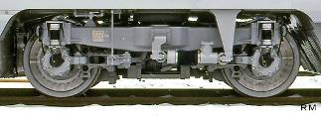
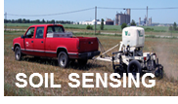
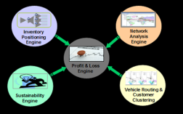
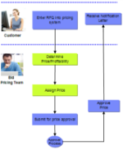
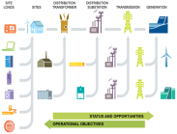
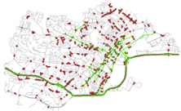
Our current focus areas
Predictive Asset Management
Smarter Workforce
Smarter Agriculture
Globally Optimized Enterprise (fraud, finance,
supply chain and logistics, pricing)
Intelligent Infrastructure (traffic, buildings,
energy, manufacturing)
Analytics Visualization
Statistics/ML Core Methods
Analytics Platforms
Discrete Optimization
Decision Making under Uncertainty

Slide 12
What skills are key for a business analyst/statistician with an undergraduate statistics degree?
Interpersonal
Written and spoken communication
Problem solving skills (i.e. THINK about your results and whether they make sense!)
Time management/multitasking
Flexibility
Technical
Ability to manipulate/cleanse data
Some experience with math/stat modeling languages (R/SAS/SPSS/Matlab)
Good grasp of “basic” statistics, including summary statistics, regression/linear models, and univariate time series modeling
Ability to read and understand statistics/machine learning literature and determine whether a (new) method is appropriate for your data

Slide 13
Building Towards Big Data and Data Science
Michael Rappa
Institute for Advanced Analytics
North Carolina State University
http://analytics.ncsu.edu

Slide 14
Preparing Students for Big Data
Expose students to messy data problems and data cleaning methods
Deploy students in team-based exercises where teamwork skills are emphasized
Give teams opportunities to present their work whenever possible
Introduce data visualization methods
Big Data capstone course

Slide 15
All I Ever Needed to Know I Learned as an Undergrad
Chris Volinsky
AT&T Labs-Research

Slide 16
It’s been a long time…
Notes:
Havent been in undergrad in a long time..dont know much about curricula

Slide 17
What was in Freund and Walpole?
Just what you would expect!
Probability Theory
Testing
Estimation
Reflected the jobs at the time – lots of examples about manufacturing, engineering, etc.
How has the world changed:
Statistics is now “'the sexy job in the next 10 years.”
Notes:
note: this was in 2009 so we still have some time

Slide 18
Why did undergrads take statistics?
They had to
They liked math and want to apply it to something interesting
They grew up reading about baseball statistics specifically Bill James and really wanted to understand how to analyze baseball data so they could one day work for the Yankees
Perhaps too autobiographical..
No wonder everyone hates stats!
So now why do they take stats?
Because it is sexy. So how do we tap into that?
Notes:
Testing and estimation doesn’t correlate with those needs.

Slide 19
How to make it sexy?
… or at least relevant?
Real world examples
Programming skills
Hands-on data analysis
Problem solving
But none of this actually falls under the category of statistics
Notes:
I began to think about what was it that I thought undergrads needed to know, that I did not acutally learn until I got into the real world.
The problem is..

Slide 20
What is most valuable in Statistics education?
The language of uncertainty and error
The mechanics of probability
Natural skepticism
Empirical methods – monte carlo tests, bootstrap, etc.
Exploratory data analysis techniques
Non-parametrics
These things are still important – even when the data is big!!
Breadth not depth? Fill the toolbox!! Time series, spatial, forecasting, classification, clustering.
Don’t over-focus on classical hypothesis testing
Notes:
Uncertainty is such an underrated skill! It is not an intuitive concept for humans and is so important in everyday life.
Empirical methods – monte carlo tests, bootstrap.
This is what distinguishes us from other fields.

Slide 21
Hilary Parker
Data Analyst
@hspter

Slide 22
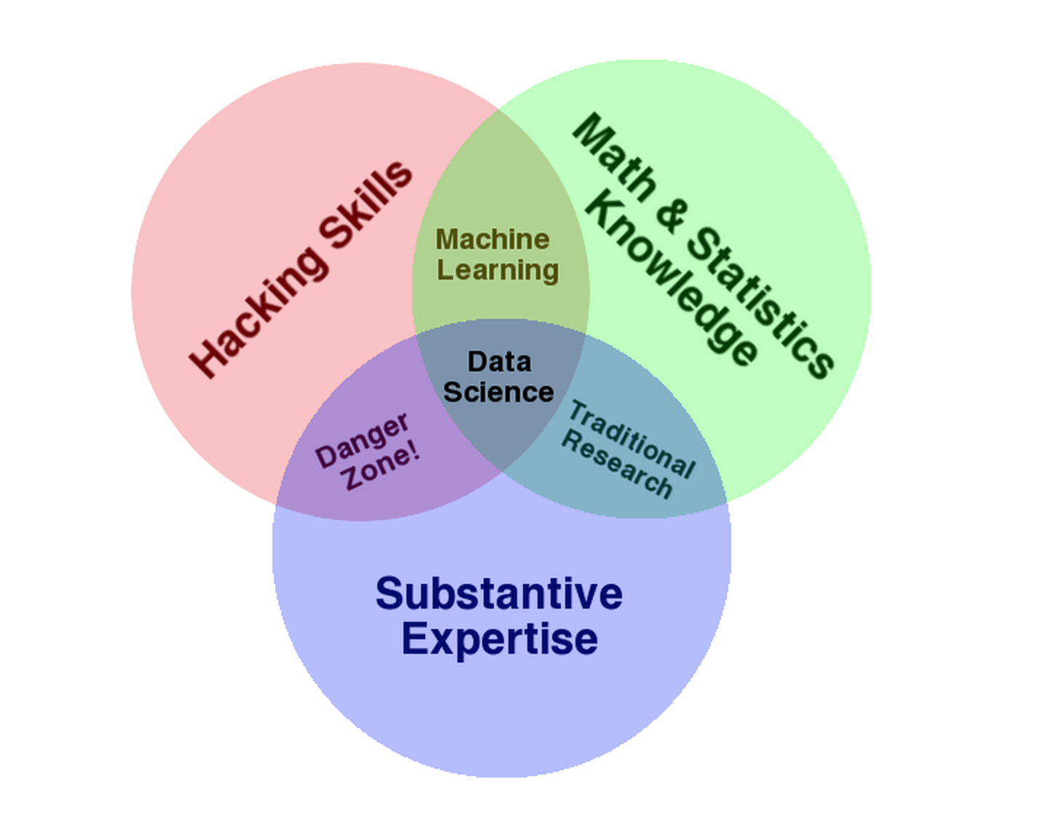
http://drewconway.com/zia/2013/3/26/the-data-science-venn-diagram

Slide 23
Data at Etsy

Slide 24
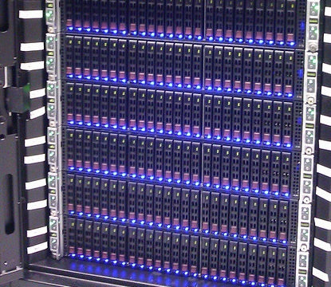
Data
Engineering

Slide 25
Data Analysis
Data Analysts
https://www.etsy.com/listing/48582479/standard-normal-distribution-plushie
https://www.etsy.com/listing/103098547/cutie-pie-chart-red-green-blue

Slide 26
Personalization

Slide 27
Questions for Panel (I)
What ideas do statisticians teach well that other disciplines don’t teach as well?
Insights?
Analysis tools?
Problem solving approaches?

Slide 28
Questions for Panel (II)
If you could add anything to or change any part of the statistics curriculum, what would it be?
Topics?
Teaching techniques?
Skills?
What could be removed from the statistics curriculum?
What math should the statistics BA graduate know?

Slide 29
Questions for Panel (III)
How do traditional statistical ideas fold into big data analytics?
Inference?
Sampling?
Causal reasoning?

Slide 30
Questions for Panel (IV)
What do you see as statisticians’ unique niche in the area of Big Data? What is the role that only we can play?

Slide 31
Questions for Panel (V)
What is the role of statistics at your institutions?
How much time do you spend analyzing data?
How much time do you spend designing experiments or otherwise collecting data?
What tools do you find useful for your work?
In hiring, how important is knowledge of a particular tool as compared to facility with many tools?
What do you look for when hiring statisticians?

Slide 32
Discussion
More information about the existing curriculum guidelines as well as a survey can be found at:
http://www.amstat.org/education/curriculumguidelines.cfm

